Slide 1
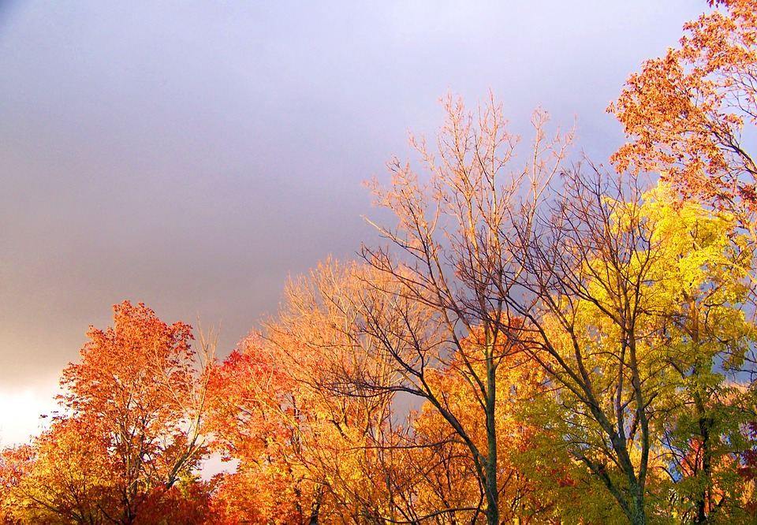
Weather Forecasting Website
Bhaskar Kulshrestha
2001641530020
B.Tech second year - CS (AI and ML)

Slide 2
Introduction
Weather forecasting is the prediction of what the atmosphere will be like in a particular place by using technology and scientific knowledge to make weather observations. In other words, it's a way of predicting things like cloud cover, rain, snow, wind speed, and temperature before they happen.

Slide 3
Weather forecasting is the application of science and technology to predict the conditions of the atmosphere for a given location and time. Weather forecasts are made by collecting quantitative data about the current state of the atmosphere, land, and ocean and using meteorology to project how the atmosphere will change at a given place. Once calculated manually based mainly upon changes in barometric pressure, current weather conditions, and sky condition or cloud cover, weather forecasting now relies on computer-based models that take many atmospheric factors into account.

Slide 4
Methodology
The processes we have used are as follows :-

Slide 5
The Programming of the code is using the 4 concepts, namely :
HTML 5
CSS 3
JAVASCRIPT
API – Application programming interface

Slide 6
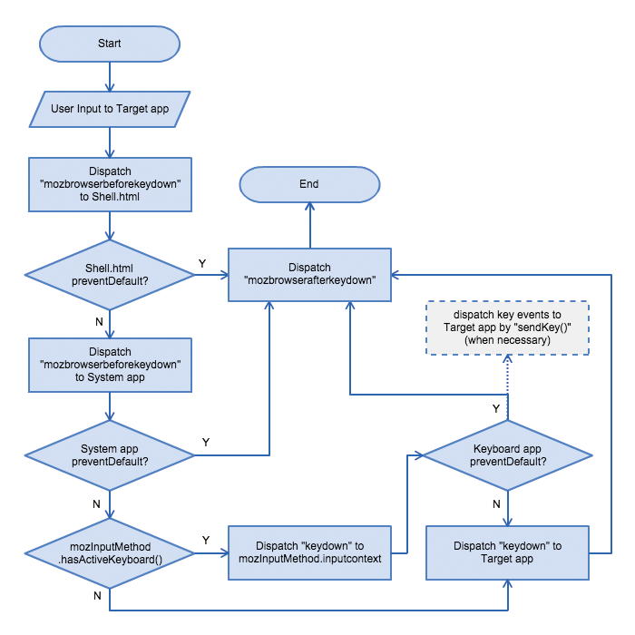

Slide 7
Application
Weather Forecasting.
Check the weather to plan your day.
Precautionary measures can be taken before any disaster happen.
To Predict the climate of a location and to study climate changes.
Future climate prediction (example – prediction of rainfall ).

Slide 8

Project Requirements
INTEL PROCESSOR (7TH GEN OR ABOVE) and AMD’s 2nd generation Ryzen 5’s and 7’s or higher.
WINDOWS 10 OPERATING SYSTEM(RECOMMENDED)
SSD STORAGE FOR FASTER REVIEW BUT NO WORRIES HDD WILL ALSO WORK.
A STABLE INTERNET CONNECTION FOR FASTER ACCESSING .

Slide 9

Results
User is able to check the weather of any part of the world .
User will be able to operate it in any device .
Users will be able to study the climate changes .

Slide 10
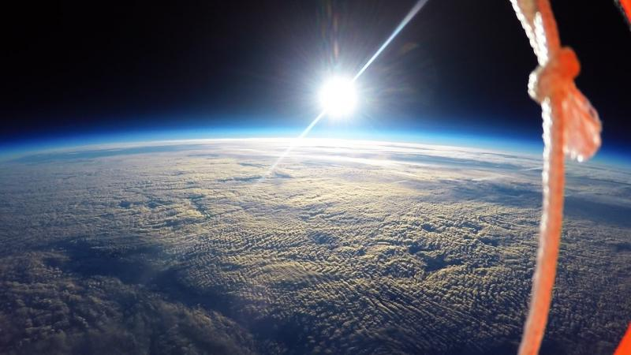


THANK Y U
The environment is where we all meet; where all of us have a mutual interest; it is the one thing all of us share.

